Slide 1
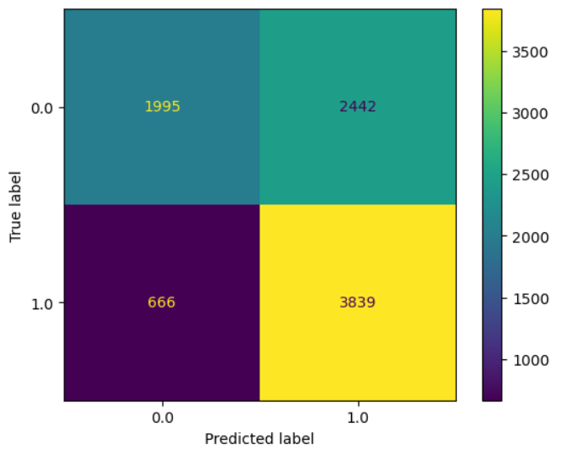
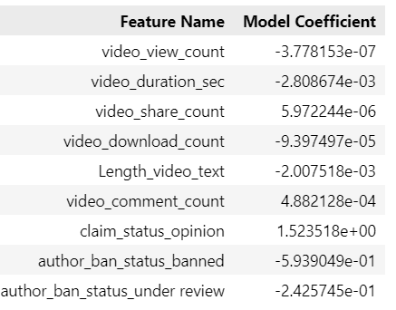
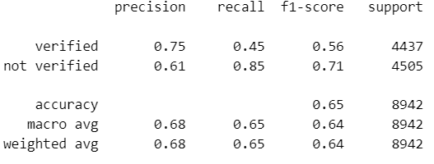
Logistic Regression Analysis for TikTok Project
Executive summary report
Project Overview
The TikTok data team seeks to develop a machine learning model to assist in the classification of claims for user submissions. In this part of the project, the goal is to build a regression analysis to forecast user’s verified status
Upper-left: the number of videos posted by unverified accounts. Upper-right: the number of videos posted by unverified accounts. Lower-left: the number of videos posted by verified accounts. Lower-right: the number of videos posted by verified accounts.
- The dataset has few strongly correlated variables. We dropped `video_like_count` from the model building.
- Based on logistic regression model, each additional second of video is associated with 0.0028 increase in the log-odds of the user having a verified status.
The logistic regression model had an acceptable predictive power: a precision of 61% is less than ideal, but a recall of 86% is very good. Overall accuracy is towards the lower end of what would typically be considered acceptable.
We developed a logistic regression model for verified status based on video features. The model had decent predictive power. Other video features have small estimated coefficients in the model, so their association with verified status seems to be small.
Claim status and author ban status are biggest predictors of verified status. However, given ultimate goal is to predict claim status, this would become a circular model
Image Alt-Text Here
The next step will be to build a regression model on claim status. A regression model is the natural next step because the end goal is to make predictions on claim status.

